Slide 1
Home Front to Front Line The White Lund Disaster, 1917
Corinna Peniston-Bird, Lancaster University

Slide 2
The Home Front in the Front Line: Munitions* in the First World War Corinna Peniston-Bird Lancaster University
Munitions: military weapons, ammunition, equipment, and stores.

Slide 3
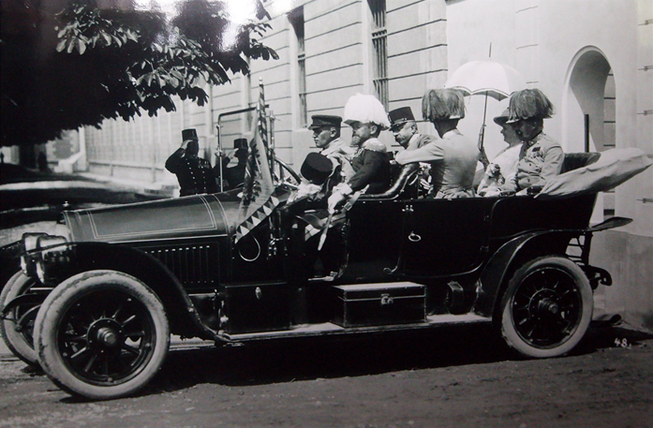
The assassination took place on 28 June 1914: by August, Europe had erupted into war.

Slide 4
Soldiers needed warmth, camouflage and protection: jacket, trousers, boots, great coat, hat/helmet, webbing for water bottle, ammunition, rifle, bayonet…
Notes:
Pupils might want to think about just how many boots, rifles, coats, flasks etc would need to be produced in order to equip five million men. Nearly half a million volunteered in the first two months of the war.
By the end of the war, almost 1 in 4 of the total male population had joined up. To visualise this, all pupils could be asked to stand. All the girls need to sit down if there are boys and girls in the class. Then the boys could go around the room counting off one to four: everybody who said the number four served in the Armed Forces. Of the men who served, 11.5 per cent were killed.
Should the girls complain about their exclusion, women did serve in the newly formed Auxiliary Services. You can find a list of these here: see https://www.longlongtrail.co.uk/army/regiments-and-corps/women-and-the-british-army-in-the-first-world-war/) Females only saw combat in Russia, but in Great Britain and America they served not only as nurses, but also in the auxiliary services taking over certain jobs to enable men to take combat roles. Over 100,000 women joined: around 800 of them are recorded as dying during the war. We know of some of the local women who served: the Roll of Honour in Carnforth Christ Church includes Florence May Holroyd; Caton Village Memorial includes Clementina Addison, who trained as a nurse at the age of 26, and went to the front In 1915 to care for soldiers in the trenches at Verdun. Becoming ill, she returned home and died in March 1916. Another nurse is listed on a plaque in Lancaster Priory: nurse Muriel Beatrice Ogilvy, who began her service aged 39 on 26 July 1915. She died in November 1920. The Bowerham Primary School Roll of Honour, unveiled by the Lord Lieutenant of Lancashire, the Rt. Hon. Lord Shuttleworth on 8 July 1919, lists service as well as death, and includes six female names, distinguished by the inclusion of first names and by being colour coded. The roll of honour in Yealand Conyers St John includes the name of Minnie Western Lund, whose Commonwealth War Grave headstone is in the Churchyard. She served in the Queen Mary Army Auxiliary Corps, and died in March 1919 aged 24.

Slide 5
Notes:
When war broke out in 1914, there were 212,000 women working in the munitions industry, This had increased to 950,000 by the end of the war. Women were paid less than men: by 1918, the average male wage in the munitions industry was £4 6s. 6d. while women only received £2 2s. 4d. The emphasis on ‘back’ in the sound track is a reference to the fact that it became more acceptable for married women to work during the war, which brought women ‘back’ to the factories they had left on marriage.

Slide 6
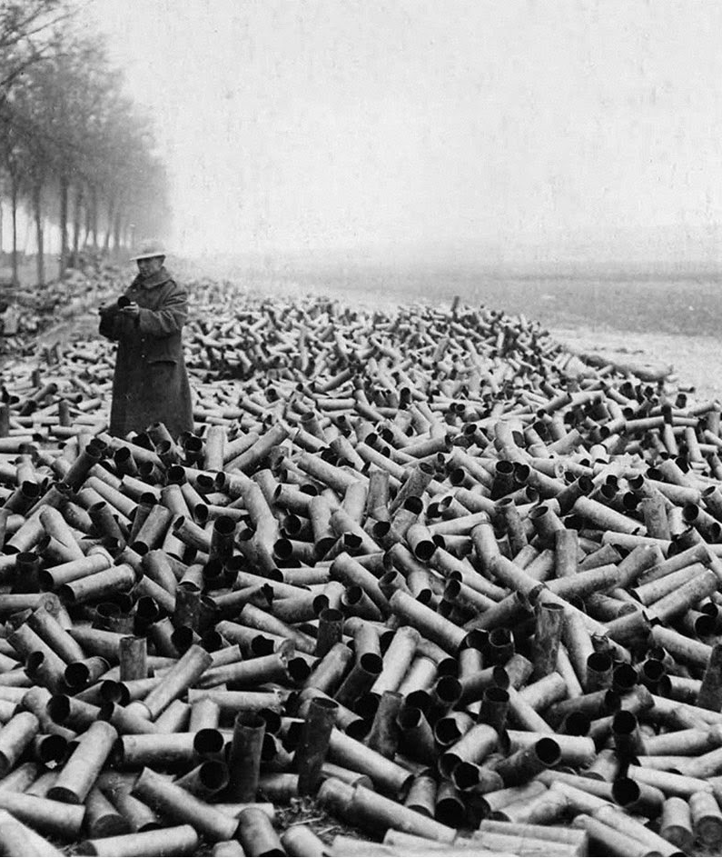
Before and After: Shells in the War
US ARMY/SCIENCE PHOTO LIBRARY / Universal Images Group
Rights Managed / For Education Use Only
Notes:
In the first eight days of the Somme (1916), 1.73m rounds were fired, of which a significant proportion were duds; the comparable figure at Messines in 1917 was 3.25m with far fewer failing to explode. Pupils might like to consider the logistical challenge of transporting all those shells between factories in Britain, and then to the Battle Front.

Slide 7
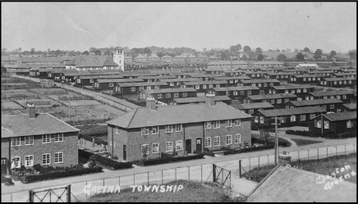
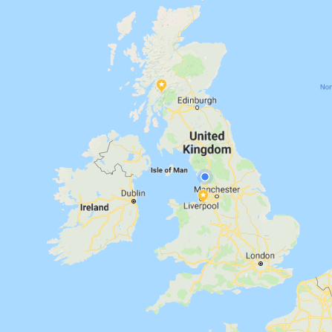
NFF
NPF

Slide 8
Lancaster’s Projectile Factory, Caton Road

Slide 9
Notes:
8656 employees to be precise!

Slide 10
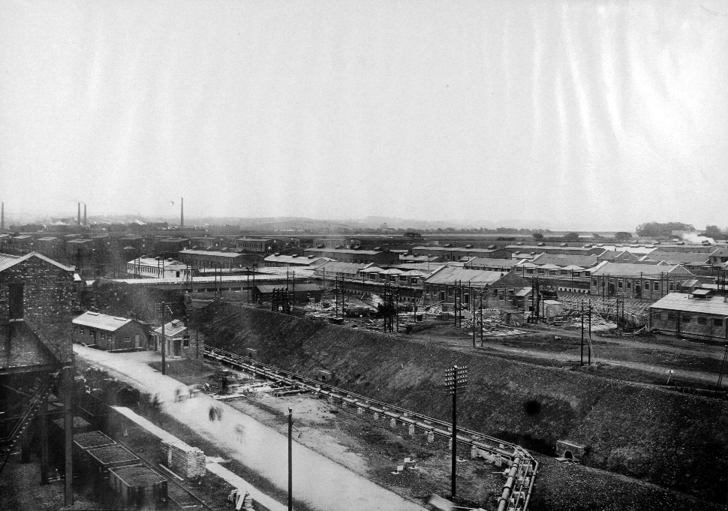
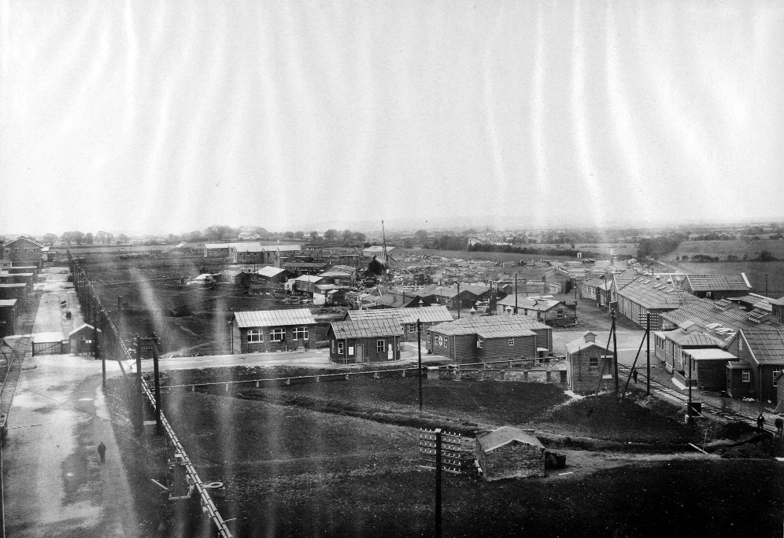
National Filling Factory (No.13), White Lund
Images courtesy of Lancaster City Museum
Notes:
The NFF site opened in the summer of 1916, with sixteen bonded stores, paint shop, shell store, magazines, power station, and six ‘danger’ huts . 6in howitzer, 8in High Explosive (HE) and 60-pounder HE were dry- or wet-filled. Amatol, a mixture of TNT and ammonium nitrate, was cheaper than TNT and in readier supply.
These were dangerous places to work. Workers had to change their clothes – just in case, for example, they had metal buttons that could have caused a spark. In Gretna, for example, in 1917 there was an explosion which killed Roberta Robertson and injured nine further women. We don’t always know what happened until later in the war because the government kept these accidents a secret. We do know some women were given war service medals for having helped people although endangering themselves.

Slide 11
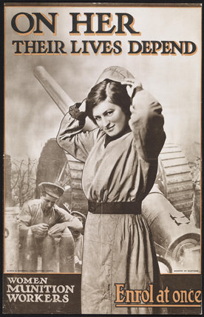
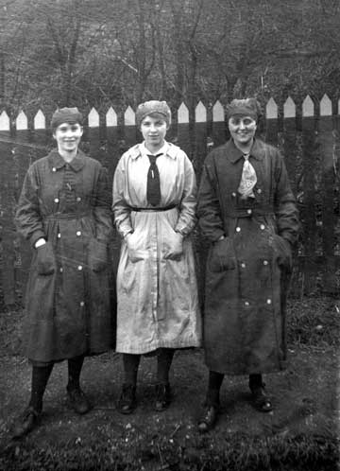
Workers at the National Filling Factory on the White Lund
On the right is Mrs Mable Curwen, wife of Private Arthur Curwen, with two other munition workers.
Image courtesy of King’s Own Royal Regiment Museum, Lancaster.
Notes:
Ian F. W. Beckett (2012) The Making of the First World War argued that p: The ministry [of munitions] provided facilities for its own employees, and spent some £4.3 million on housing, building 10,000 permanent homes on 38 sites such as the Well Hall estate in Woolwich, at Eltham, and at Gretna, since commercial builders had little incentive to provide low-cost housing.

Slide 12
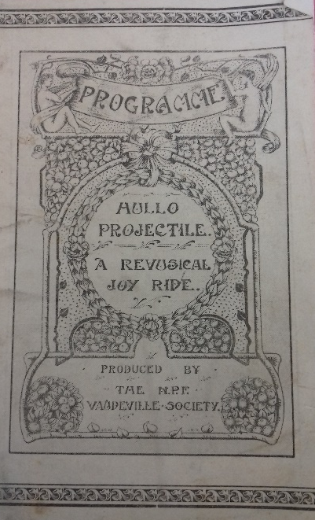
The Programme for one of the shows put on by workers of the Projectile Factory
Image courtesy of The King’s Own Royal Regiment Museum, Lancaster
Buses taking workers from Lancaster city centre to the NFF on the White Lund. Other workers walked or cycled.

Slide 13
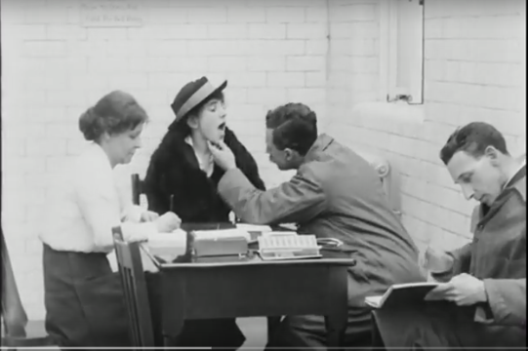
DANGEROUS WORK
Still from the wartime film ‘A Day in the Life of a Munition Worker’ showing a factory medical examination.
Notes:
Over 200 women lost their lives through accidents, explosions, or poisoning from handling chemical explosives in the war. See, for example, nine accounts of the types of danger, from poisoning, explosions, to noise.
https://www.iwm.org.uk/history/9-women-reveal-the-dangers-of-working-in-a-first-world-war-munitions-factory

Slide 14
INFERNO Evening of 1 October 1917. 537 men and 813 women on evening shift. 10 pm: Break for Supper
Image courtesy of The King’s Own Royal Regiment Museum, Lancaster

Slide 15
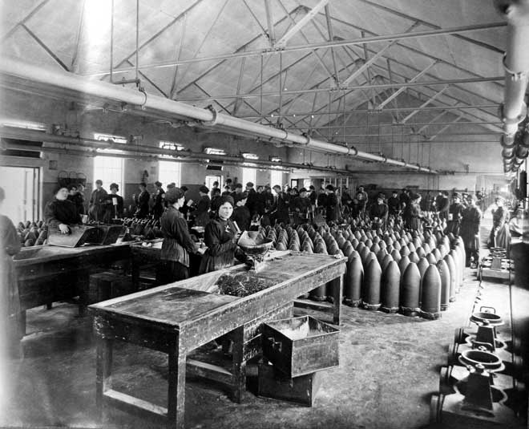
Image courtesy of King’s Own Royal Regiment Museum, Lancaster

Slide 16
1 –3 October.
.
Monday 1st October
c6pm | Nightshift began. 2000 workers
9 – 9.40 pm | 12” shells filled with TNT mix in Unit 6C. Other shells filled in other units.
10 pm | Supper break.
c10.15 pm | Fire. “flames issuing from the roof of No. 6 Stemming House”
 | Workers rushed to Main Gate, gate closed. Change houses opened for workers to escape Dangerzone.Firemen and workers tackled fire.
10.30 pm | Large explosion heard as far away as Nelson. Multiple small fires developed. Shells exploding. Site electricity failed. Only light is moonlight and that provided by fires. One water pump stopped working.
 | Explosions continuous throughout the night
 | Kew and Graham moved wagons filled with shells out of the Dangerzone.
11.10 pm | Firemen, police and workers at Main Gate ordered to take cover – stayed under the railway bridge. Site too dangerous. Power House workers remain
Tuesday 2nd October
2.25 am | Blackpool ambulance arrived.
2.45 am | Disberry, Pump Manager, blown through window by explosion Fireman turned off water pump.
3 am | Another huge explosion, heard in Burnley.
Dawn | Lancaster and Preston Fire Brigades arrived and flooded the magazines. Low water pressure in main pipe.
 | Rumour of further massive explosion prevents locals returning home
Morning | Vickers staff arrive. Workers paid off.
PM | Blackpool fire engine and ambulance arrive. Manchester Fire Brigade arrive. Fight fires at Main Gate and Discharge/Change Houses. Water supply low.
 | Preston, Chorley and Barrow fire services flood the T.N.T. Magazines.
3.10 pm | Blackpool ambulance relieved by Fleetwood and Kendal ambulances
 | Liverpool and Vickers Barrow fire engines arrive. Fulwood fire engine tackled the Charge House fires. Liverpool and Manchester the Bonded Stores
Wed 3rd October
Night time | Several fire engines worked together to provide a water supply to enable them to tackle the fires remaining in the Dangerzone
4.15 am | The last large explosion. Fire fighters withdrew till dawn.
5.45 am | Resumed fire fighting.
Daylight | All fires under control or out. Locals returned home. Much damage.
2.30 pm | Mayor of Lancaster admitted shutting off water supply to site as they thought it was being wasted. Water supply restored.
 | 7 bodies found
Evening | All fires were out. Cooling work. Rained heavily.
Notes:
This timeline allows interesting exercises in empathy: how every sense would have been affected for the workers on site, but also what local people living in the surrounding towns might have thought was happening.

Slide 17
Escape to Safety!

Slide 18
FIRE BRIGADES CAME FROM ACROSS THE REGION
Notes:
Help came in from Fire Brigades far and wide …
White Lund had its own Fire Brigade and the site was fitted with hydrants and sprinkler systems along its runways although these had to be turned on manually. The works Fire Brigade of 30 men were well drilled. Even so, the scale of the emergency was soon overwhelming. Lancaster's Fire Brigade and those from the Asylum (later the Moor Hospital) and Morecambe voluntary service also attended on 1 October but they could not have contained the blaze.
A range of fire services arrived on 2 October. Some had contacted Lancaster Police and others were telephoned by Vickers in Barrow. Some had travelled very long distances to assist; all worked tirelessly to fight the fires:
By pooling manpower, machinery and expertise the site was finally declared safe in the morning of 4 October. Fire fighters had worked solidly and bravely despite the challenges of poor water pressure, some incompatible equipment and the lack of electricity.
Name of Brigade Date and time of arrival
Lancaster 1st October 11.0 pm
Morecambe 11.0 pm
Preston 2nd October 6.30 am
Barrow Corporation 2.0 pm
Chorley 2.10 pm
Manchester 2.30 pm
Blackpool 2.40 pm
Fulwood 4.10 pm
Messrs Vickers Ltd. Barrow 4.30 pm
Salford 4.30 pm
Leyland 5.0 pm
Bolton 5.25 pm
Messrs Horrockes, Crewdson and Co. 5.30 pm
Preston

Slide 19
Lancaster Guardian, 6 October 1917
Notes:
This is all the people were told. Not where it is, not what happened, not about the deaths. It wasn’t until after the war the story could be told. Can pupils suggest why that was? What do pupils think the local population wanted to know?

Slide 20
Memorial erected in 2017 by Heaton with Oxcliffe Parish Council
Notes:
Roll of Honour for those killed at White Lund
John Crowther, Unit Foreman, aged 37 years
Ernest Duester, Fireman, aged 26 years
Firth Dole, Engineer Fitter's labourer, aged 32 years (died at Morecambe Cottage Hospital)
Alfred Hays, Munitions worker, aged 44 years (not identified immediately)
James Inglesent, Fireman, aged 38 years
Frederick Leslie, Fireman, aged 38 years
Thomas Henry Peck, Fireman, aged 39 years
Hebert Peverall, Labourer, aged 25 years
Henry Thomas Taylor, Overlooker, aged 26 years
William Topping, Shell Searcher, aged 27 years (died at Lancaster Royal Infirmary)
They are not named on this memorial. Both Lancaster and Morecambe’s central war memorials list the dead of the Armed Forces: do pupils think these men deserve to be named?
Afterall, not all the deaths on the Lancaster war memorial record death in battle. For example:
Thomas Tite of 4 Trafalgar Road, Bowerham, died in a training ground accident;
Percy Saul of 9 Springfield Street died of pneumonia while stationed near Cambridge;
George Nicholas Wilkinson of 34 Aldcliffe Road was killed by a snake in India and died on 20 April, 1918
John Hewartson of 14 Albion Street was killed by a train near Reading with the 1st/5th while guarding the Great Western Railway
All appear on the memorial, as does the unfortunate Henry Broe of 8 Vincent Street, Primrose, who was ‘shot whilst drunk by a friend at Westgate on Sea.’
So should the men who died at the White Lund be remembered by name?

Slide 21
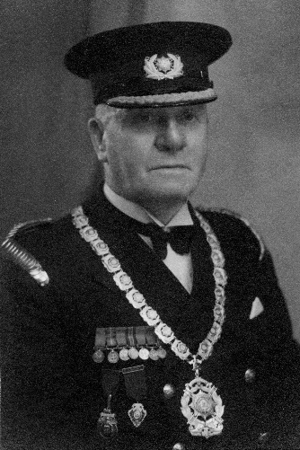
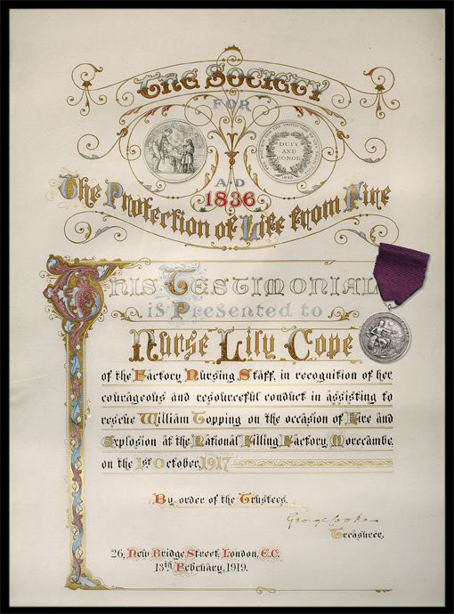
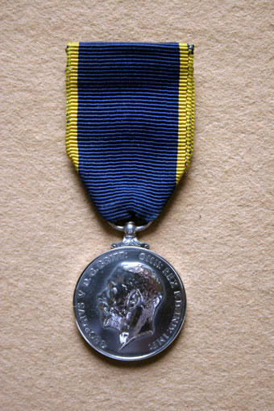
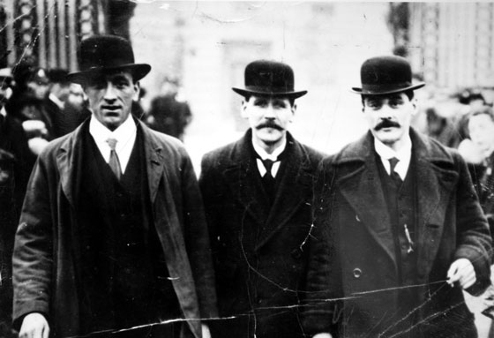
Daniel Devine Sloan, Second Officer, Manchester Fire Brigade (King’s Police Medal)
Image courtesy of Bob Bonner, Greater Manchester Fire Service Museum.
Albert Graham, Thomas Coppard and Thomas Kew leaving Buckingham Palace after receiving their Edward Medals on 7 May 1918.
Images courtesy of King’s Own Royal Regiment Museum, Lancaster
Certificate from The Society for the protection of Life from Fire, to Nurse Lily Cope, with her medal.
Notes:
In the weeks after the explosions at White Lund the Ministry of Munitions and the Home Office attempted to pin down exactly what had happened and why. Eyewitness statements from workers and fire brigades indicated that individuals had acted with great courage and devotion to duty. It was well understood that they deserved public recognition .
The authorities had the difficult task of assessing individual contributions and deciding on the type – and level – of award to give. The Ministry of Munitions [?] recognised that:
'It will probably be found that others besides those already put forward by the Ministry are deserving of recognition. The conditions were so appalling during the first 24 to 36 hours that almost everyone who took part in the work of saving the magazines and fighting the fires would seem worthy of distinction.'
The announcement of the awards was made on 7 May 1918. It maintained the veil of secrecy stating only that they were 'on account of their gallant conduct on the occasion of a fire which occurred at a Munitions Factory on the 1st October 1917.'
Edward Medal (Silver)
Two versions of the Edward Medal, introduced in 1907, were awarded for bravery in “Mines” and “Industry” – with each type having a Silver and Bronze version. Of the 188 Industry medals awarded, only 25 Silver awards were made between 1907 and 1949 – four of which for the explosion in Morecambe. The medal is rarer than the Victoria Cross!
Thomas Kew, engine driver who drove ammunition trucks full of live shells out of the danger zone
Thomas Tattersall, works fireman, for bravery
Abraham Graham, railway shunter, for bravery working with Thomas Kew
Thomas Coppard, Police Sergeant, for his part in rescuing several people from a blazing factory where he was one of the police guards (his medal is on display)
King's Police Medal
Fred Brocklehurst, Deputy Superintendent, Bolton Fire Brigade
William Bramwell Hodgson, Superintendent, Morecambe Fire Brigade
D'Arcy Benson Moffat, Superintendent, Vickers' (Barrow) Fire Brigade
Richard Newsham, Superintendent, Barrow Corporation Fire Brigade
George Albert Oakes, Chief Inspector, Liverpool Fire Brigade (his medals are on display)
Alonzo Savage, Superintendent, Preston Fire Brigade
Daniel Devine Sloan, Second Officer, Manchester Fire Brigade
William Andrew Wearing, Inspector, Lancaster Fire Brigade
Medal of the Order of the British Empire
Mary Agnes Wilkinson, Telephonist (her medal is on display)
John Caton, Boiler Attendant
Alexander Chamberlian, Shift Engineer in the Power House
Nurse Lily Cope, Factory Nursing Staff
William Disberry, Pump Attendant, aged 70 years
Sergeant Richard Garth, Lancaster Fire Brigade
William Heald, Feed Pump Attendant in the Power House
George Hutchinson, Boiler Fireman in the Power House
Jilbert Johnson , Works Police Constable
George Nutt, Boiler Attendant in the Power House
William Seery, Works Police Constable
Nurse Maisie J Shepherd, Factory Nursing Staff
Charles Taylor, Foreman
Richard Taylor, Fireman in the Factory Fire Brigade
Grace Calrow, Driver of the Factory Motor Car
Gold watches
17 male members of staff at White Lund were awarded gold watches in recognition of their bravery. We do not have a list of all these men but we do know that Howarth Nuttall, Clerk at White Lund, was one of the recipients.
Morecambe NFF Staff: Gold Watches
Albert Dudson
Edwin Howarth
William G. Kirkup
William Lee
James Vysick
Albert Shaw
Fred Harrison
Ernest B Blackwell
William Tuley
George Duxbury
Alfred Adage
Alfred Gill
Howarth Nuttall
Leonard Thomson
Edward Legge
Thomas Walker
Herbert Arthur Tennent
These are listed in a letter from The Controller of Gun Ammunition Filling, Ministry of Munitions of War, London, 12th March 1918 to and by request of Mr Delevingue, Home Office.
Lord Shuttleworth, Lord Lieutenant of the county, distributed many awards for bravery and paid tribute to the valour and deeds of heroism of women and men. Mary Wilkinson received hers on 20 April 1918, many others had to wait until 3 December 1918.
The descriptions of their acts give a sense of the dangers faced. For example, Chamberlain, Hutchinson and Heald ensured the boilers did not burst at the power house which was close to the explosions. Johnson helped women workers to flee and assisted with the fire-fighting, behaving with ‘coolness and recourse’. Charles Taylor returned to the factory on hearing the explosion, not gaining entry until 5am on the Tuesday, when he patched the Reserve Water Tank. Grace Calrow, 17 years of age, was drove the driver of a factory motor car at the time of the explosionin and about the danger zone remaining on duty for three full days and two full nights. Nurses Lily Cope and
Maisie J. Shepherd ‘assisted in getting the wounded away from the Factory after the explosions had taken place. Both behaved with great courage, and performed their duties quietly and without regard to their personal safety” Tuley, for example, was a steam fitter in No. 6 Unit. He was blown off the runway when investigating the flames; fetched a stretcher for an injured man but the roof of the charge house collapsed on him. He carried the man to cover, despite his injured arm.
Grace Calrow, aged 17 years, who was, and who is now driving one there. At 10.40 on the night of the fire she was called out, drove one of the works employees to the fire – she took the car fairly close to the factory – well witin the danger zone, took cover behind the motor car till 4.10 the next morning, after that she was continually driving in and about the danger zone with various officials, and bringing up food
Tuley, for example, gives a statement: I am a steam fitter in No. 6 Unit. I was on patrol lay on the night of 1st October;[ walked through 6C Melt at 10 minutes to ten on way to check 7c. ; told place was on fire at 20 mins past ten: I went through and saw the flames just bursting through 6 C. Melt Roof. [blown off runway; ran towards firemen, saw one baedly hurt on leg and head, ‘a discharged soldier’. Carried him out to path; ran for stretcher when the roof of the Change House came down on me; got one from no 9. Carried man to behind the power house wall. Took about an hour as my arm was hurt and we had to continually keep stopping.’

Slide 22
The least unlikely cause?

Slide 23
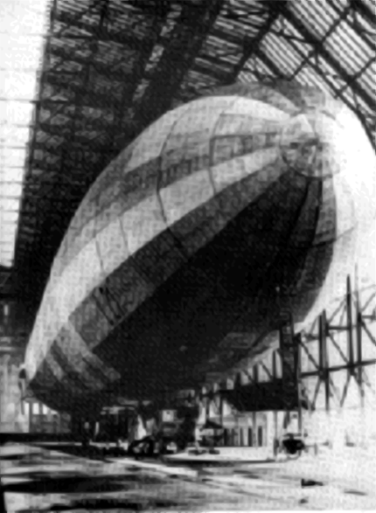
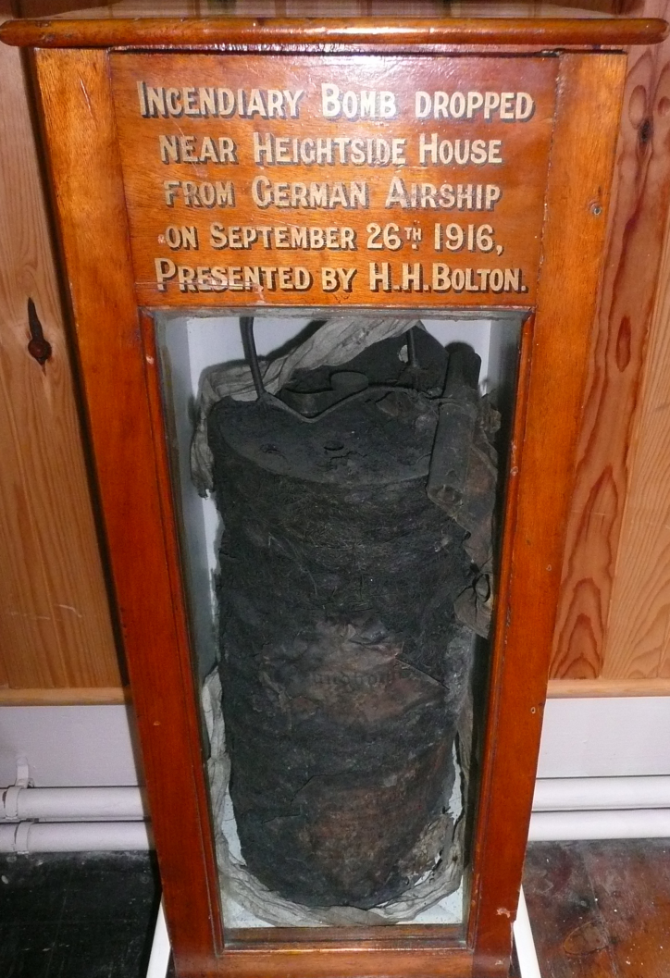
Zeppelin Airship attack September 1916 in the North West of England.
Image reproduced from http://aircrashsites.co.uk/2/
Notes:
There were two aerial attacks in the North West: the one outlined on the slide, and the second over Wigan in 1918. There were probably fewer than 50 airships involved in the air attacks on Britain: there were 12 raids on London, and 50 more elsewhere. The statistics on civilian casualties vary, but casualties from the German attacks between 1914 and 1918 may number:
Air raids (by aircraft and airships)
Dead: 1117 (including 252 children)
Wounded: 2886 (including 542 children)

Slide 24
Industrial Accident?
Notes:
The most likely reason for an accident was workers smoking. If you weren’t allowed metal buttons for fear of sparks, you certainly weren’t allowed matches! There were fifty convictions for possessing smoking materials after the factory opened in July 1916: Smoking 9; possessing matches and cigarettes; 38; possessing tobacco 2; pipe 1. William George Strangroom, Chief of Works Police commented in his statement of 9 Oct 1917 that one of the suspects was known to enjoy a sneaky smoke.

Slide 25
Sabotage [deliberate attempt to destroy or damage]?
Spy Fever!
This cartoon by W. K. Haselden published in the Daily Mirror in November 914 pokes fun at the suspicion that German spies could be lurking anywhere in disguise.
Notes:
The cartoon shows a contemporary cartoon illustrating the spy fever that captured the popular imagination in 1914. However there were no registered aliens employed at the factory, although a Belgian had been employed soon after the Factory opened but had since been discharged. The large number of Irish employeers was also cause for concern: - between 700 and 800 women were imported from Ireland since the factory started, but two ex-detective officers were appointed on the staff of the factory to examine all applicants. The anxiety was to exclude any supporters of Sinn Fein.

Slide 26
The coroner’s verdict:
'Death in all cases was due to injuries accidently received whilst carrying out their duties in a National Factory during a fire, there being no evidence to show how the fire originated.'

Slide 27
Useful links
Nine Women reveal the dangers of working in a munitions factory
https://www.iwm.org.uk/history/9-women-reveal-the-dangers-of-working-in-a-first-world-war-munitions-factory
Watch ‘A Day in the Life of a Munition Worker’ at
https://www.iwm.org.uk/history/a-day-in-the-life-of-a-munitions-worker
Read more from the ‘Boomtown!’ exhibition at Lancaster City Museum:
http://www.kingsownmuseum.com/1917-exhibition-001.htm

Slide 28
Acknowledgements
With thanks to Sue Ashworth, Lancaster City Museum; Bob Bonner, Greater Manchester Fire Service Museum; Nigel Crompton; Peter Donnelly, The King’s Own Royal Lancaster Regiment Museum; Global Link; Steve Irwin; Vicci McCann, Lancashire Archives; Janet Nelson; Simon Phillipson; Sam Riches, Regional Heritage Centre/Elizabeth Roberts Archive; Simon Ryan, Merseyside Fire and Rescue Service; Chris Workman, and the generous support of the Department of History and the Faculty of Arts and Social Sciences, Lancaster University.
For their enthusiasm and expert guidance for the teaching dimensions, Janine MacGregor and Ruth Pearson, Moorside Primary School, Lancaster; and Lauren McDaid, Annan Academy, as well as their wonderful pupils.

Slide 29
CONTACT ME
Corinna Peniston-Bird
c.m.peniston-bird@lancaster.ac.uk

